Slide 1





TANCAM’S
HACKATHON FOR WOMEN
IN ENGINEERING
THEME: URBAN MOBILITY SOLUTION
TITLE: SMART PARKING SOLUTION
VENUE: MAHENDRA ENGINEERING COLLEGE
TEAM LEADER NAME: DHANUSHREE S

Slide 2
PROBLEM STATEMENT :
Parking management influences drivers search time and cost for parking spaces.It may also causes traffic congestion.Finding a parking space in most metropolitan areas, especially during the rush hours, is difficult for drivers.
OBJECTIVES OF THE WORK:
◇
Parking space reservation can help drivers to reduce the search time dramatically.
With the real-time reservation service, the drivers can find and reserve their desired vacant parking spaces quickly.Therefore, the gasoline and time in search of vacant parking space is reduced.
It reduces time in search of vacant parking spaces is reduced
◇
◇

Slide 3
PROJECT DESCRIPTION:
Hardware Infrastructure:Installation of sensors or cameras in parking lots to monitor parking space occupancy in real-time. Additionally, hardware components such as digital displays may be installed to provide visual information to drivers.
Mobile Application Development:Creation of a user-friendly mobile application compatible with iOS and Android platforms. The application should feature intuitive navigation, reservation functionality, and secure payment integration.
Backend System Development of a robust backend system to manage parking data, user accounts, reservations, and transactions. Integration with cloud services may be utilized to ensure scalability and reliability.
Data Analysis and Reporting Tools: Implementation of analytics tools to process parking data and generate insights for decision-making. Reporting features should provide administrators with comprehensive dashboards and customizable reports.
Testing and Deployment: Rigorous testing procedures should be conducted to ensure the reliability and performance of the system. Upon successful testing, the system can be deployed across designated parking facilities.

Slide 4
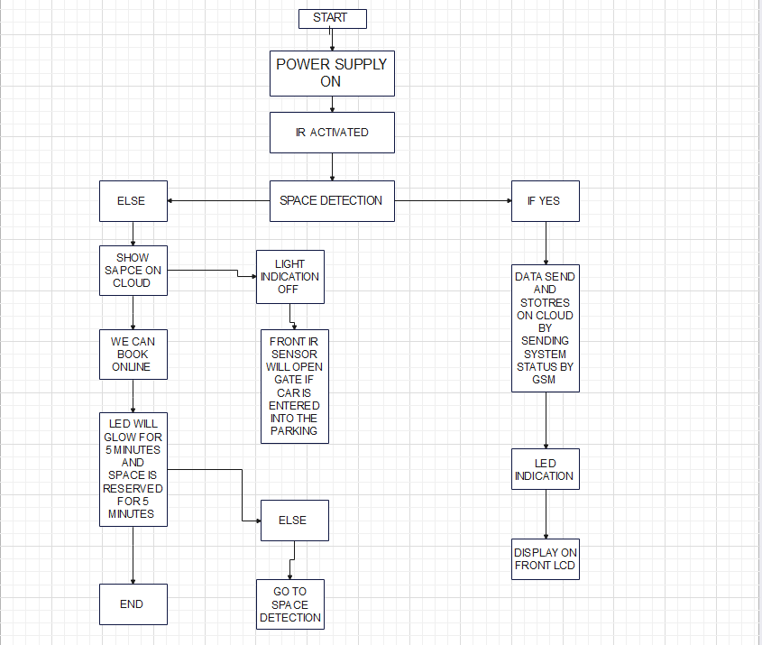

Slide 5
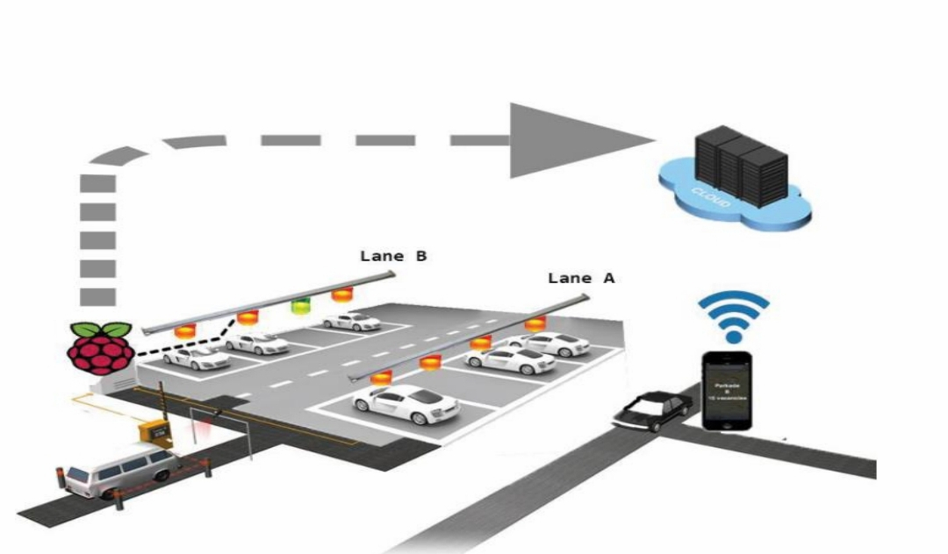

Slide 6
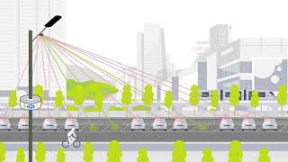

Slide 7
CONCLUSION:
WRITE YOUR PROJECT CONCLUSIONS AS BULLET POINTS.
In conclusion, the Smart Parking Management System is a game-changer for urban parking.
By leveraging advanced technologies like real-time sensors and mobile apps, it tackles parking challenges efficiently.
With features like real-time updates, navigation, reservations, and seamless payments, it enhances the parking experience for drivers and improves urban mobility.
Additionally, its data analytics capabilities empower city planners and parking facility owners to make informed decisions.
This system represents a significant step towards smarter, more sustainable cities, reducing congestion, minimizing environmental impact, and enhancing quality of life.

Slide 8
TEAM MEMBER DETAILS:
TEAM MEMBER 1
TEAM MEMBER 2
TEAM MEMBER 3
NAME:
SEMESTER:
YEAR:
DEPARTMENT:
NAME:
SEMESTER:
YEAR:
DEPARTMENT:
NAME:
SEMESTER:
YEAR:
DEPARTMENT:
TEAM MENTOR NAME:
NAME:
DESIGNATION:
DEPARTMENT:
COLLEGE:

